Slide 1
Appium Automation Framework Demo
By Ibbu
06/20/2019

Slide 2
Agenda
Parallel execution
Allure report
CI/CD and Jira integration
Report integration with Jira
Key features of framework
Framework folder structures

Slide 3
Parallel execution
Grid and nodes
Running in three devices
Two emulators
One real device

Slide 4
Allure report
Defect differentiation
Summary Graph
Jira links to defect
Detailed step report with hierarchy
Screenshots for assertions

Slide 5
CI/CD and Jira integration
It can be integrated with any CI tools like Teamcity, Jenkins, Bamboo with allure report plugin
Allure report can be seen in story wise in Jira.
Specific story test cases can be executed from CI tool.

Slide 6
Report integration with Jira

Slide 7
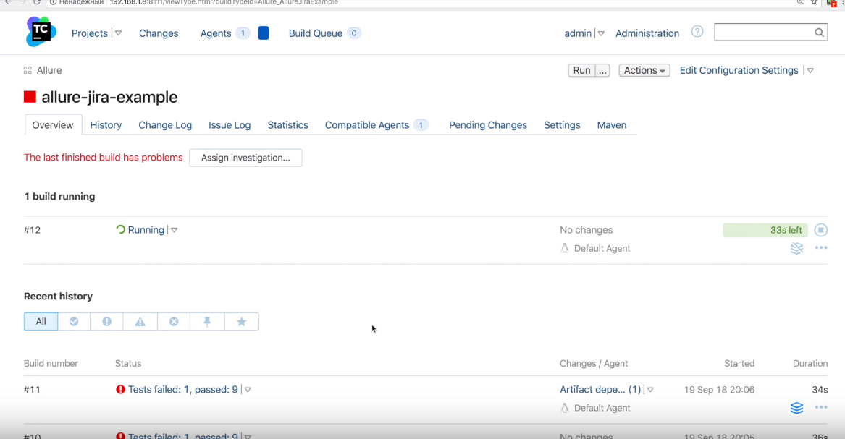

Slide 8
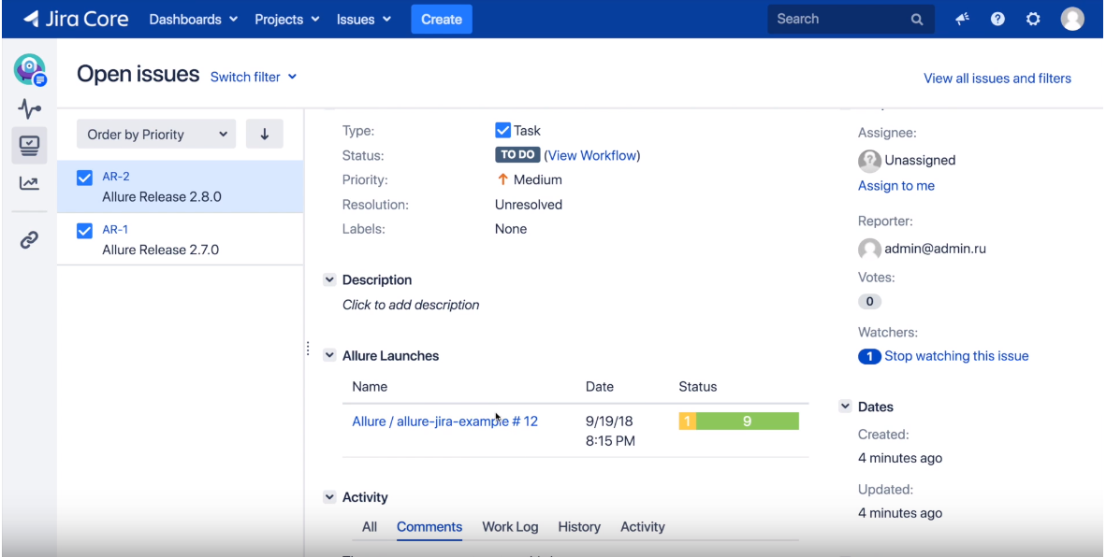

Slide 9
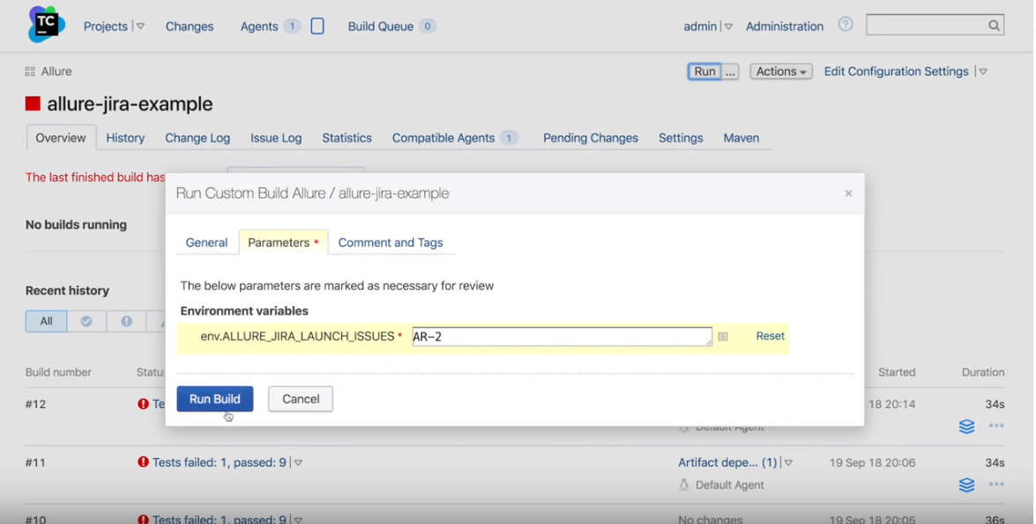

Slide 10
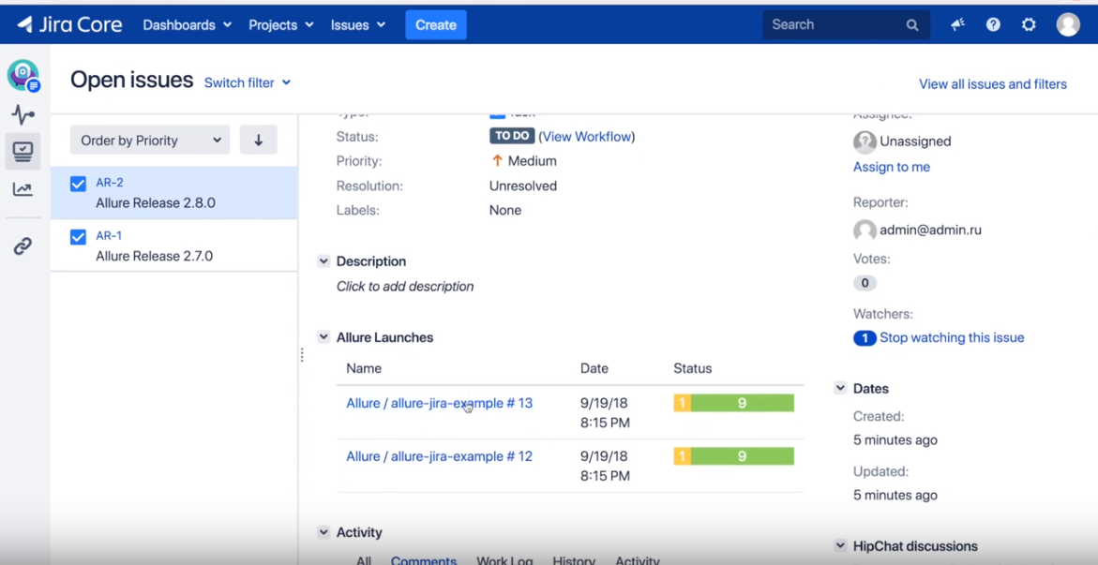

Slide 11
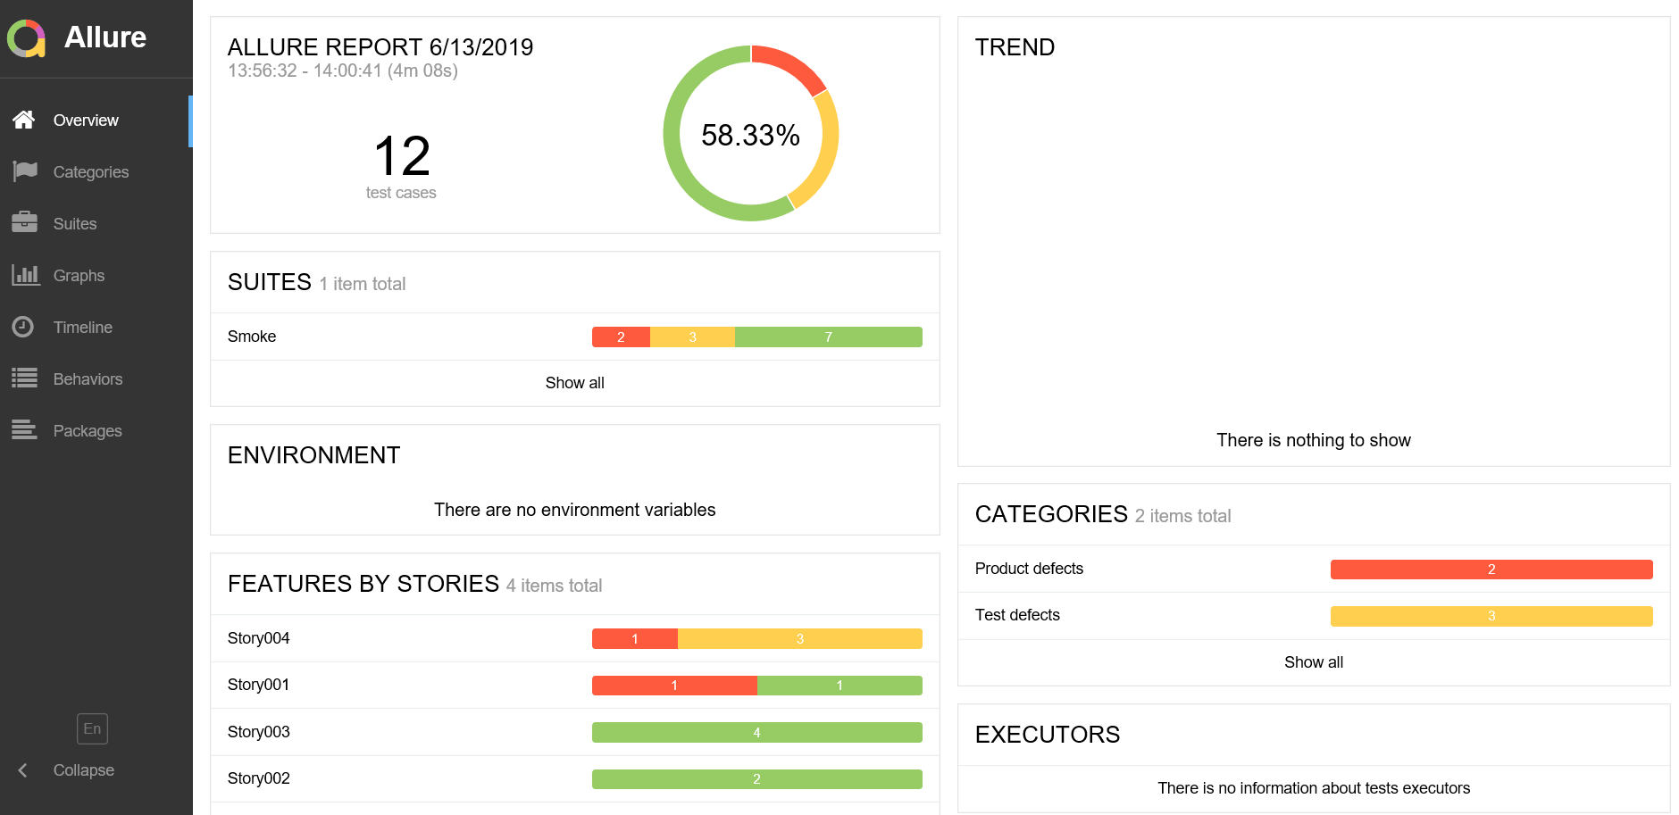

Slide 12
Key features of framework
Effective way of handling test data using java pojo class
Simplified coding for testNG annotations @Befortest,@BeforeMethod etc..
TestNG suite xml file for parallel execution
Re-execution of failed cases
Transferring data from test case to another
Exceptions handled in effective way
Code reusability
Excellent annotations from allure and testing
Running test cases in iterations for multiple data
Good folder structures
Assertion and soft assertion with screenshots
No hard coding

Slide 13
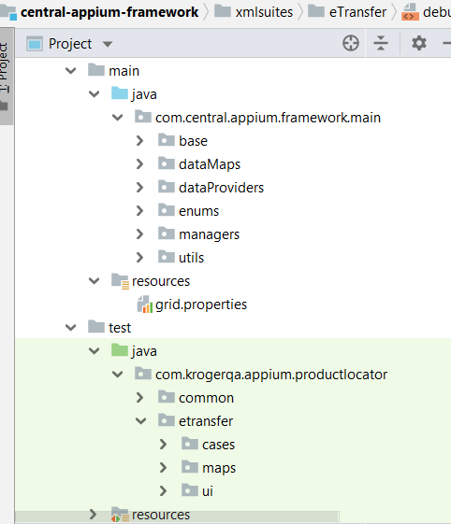
Framework folder structures

Slide 14
Questions?

